Slide 1



Heartbleed Bug!
The Beauty and Joy of Computing Lecture #14
Internet II
About one year ago, a bug of incredible magnitude was uncovered. It was an incredibly serious security hole (aka vulnerability) in OpenSSL, which provides security and privacy for the Internet (web, email, IM, VPNs, etc). You’ll read about it next week.
heartbleed.com

Slide 2
Internet: Hierarchical & Redundant

Slide 3
Definitions
Hierarchical
Redundant
Sender
A
B
C
D
F
G
H
I
J
Receiver

Slide 4
Hierarchical
en.wikipedia.org/wiki/Domain_Name_System
The Internet and the systems built on it are Hierarchical
Domain Name Syntax (DNS)
IP addresses
Benefits
Helps systems scale
york.cs.berkeley.edu
edu
stanford
berkeley
cs
cs
ee
fuji
haas
york

Slide 5
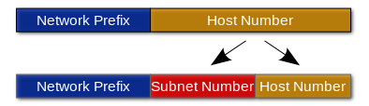
Hierarchical
en.wikipedia.org/wiki/Domain_Name_System
The Internet and the systems built on it are Hierarchical
Domain Name Syntax (DNS)
IP addresses
Benefits
Helps systems scale
york.cs.berkeley.edu
128.32.156.218
128.32
189
156
62
218
226

Slide 6
Redundant
The Internet and the systems built on it are Redundant
Routing (i.e., more than one way to get there)
Benefits
Fault tolerance (i.e., more reliable)
Helps Internet scale to more devices, people
Sender
Receiver

Slide 7
Redundant
The Internet and the systems built on it are Redundant
Routing (i.e., more than one way to get there)
Benefits
Fault tolerance (i.e., more reliable)
Helps Internet scale to more devices, people
Sender
Receiver

Slide 8
Redundant
The Internet and the systems built on it are Redundant
Routing (i.e., more than one way to get there)
Benefits
Fault tolerance (i.e., more reliable)
Helps Internet scale to more devices, people
Sender
Receiver

Slide 9
Redundant
The Internet and the systems built on it are Redundant
Routing (i.e., more than one way to get there)
Benefits
Fault tolerance (i.e., more reliable)
Helps Internet scale to more devices, people
Sender
?
Receiver

Slide 10
Redundant
The Internet and the systems built on it are Redundant
Routing (i.e., more than one way to get there)
Benefits
Fault tolerance (i.e., more reliable)
Helps Internet scale to more devices, people
Sender
?
Receiver

Slide 11
Redundant
The Internet and the systems built on it are Redundant
Routing (i.e., more than one way to get there)
Benefits
Fault tolerance (i.e., more reliable)
Helps Internet scale to more devices, people
Sender
?
Receiver

Slide 12
Redundant
The Internet and the systems built on it are Redundant
Routing (i.e., more than one way to get there)
Benefits
Fault tolerance (i.e., more reliable)
Helps Internet scale to more devices, people
Sender
?
Receiver

Slide 13
Redundant
The Internet and the systems built on it are Redundant
Routing (i.e., more than one way to get there)
Benefits
Fault tolerance (i.e., more reliable)
Helps Internet scale to more devices, people
Sender
Receiver

Slide 14
Internet: Also Hierarchical via ISPs
☑

Slide 15
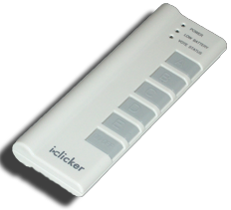
Clicker Question
Fewest nodes go down before they can’t communicate? (Excluding sender or
receiver)
1
2
3
4
5
Sender
Receiver

Slide 16
Internet: Widespread Growth, Use. How?

Slide 17
Widespread Growth, Use. How?
en.wikipedia.org/wiki/Open_standard#Protocols
Interfaces and protocols enable widespread use of the Internet
Open standards fuel the growth of the Internet.
“Open” = not owned by company
Standards for packets and routing include transmission control protocol/Internet protocol (TCP/IP).
Standards for sharing information and communicating between browsers and servers on the Web include HTTP and secure sockets layer/transport layer security (SSL/TLS).

Slide 18
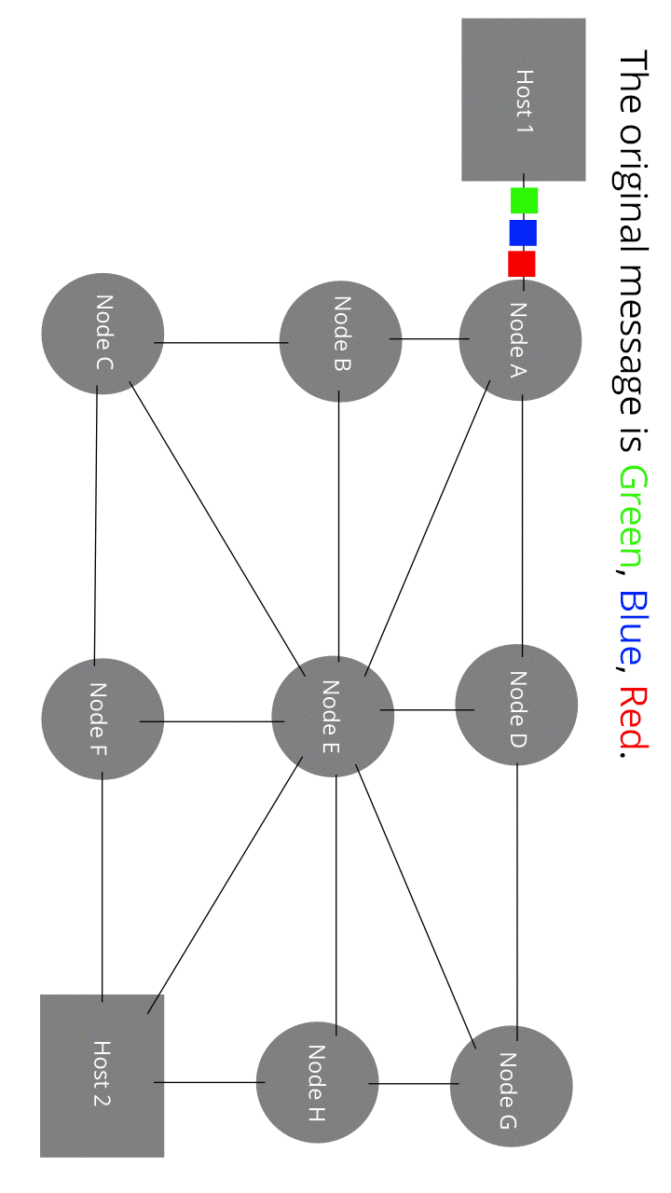
Packet-Switched System
en.wikipedia.org/wiki/Packet_switching
The Internet is a packet-switched system through which digital data is sent by breaking the data into blocks of bits called packets, which contain both the data being transmitted and control information for routing the data.
Source: Wikipedia (Oddbodz)

Slide 19
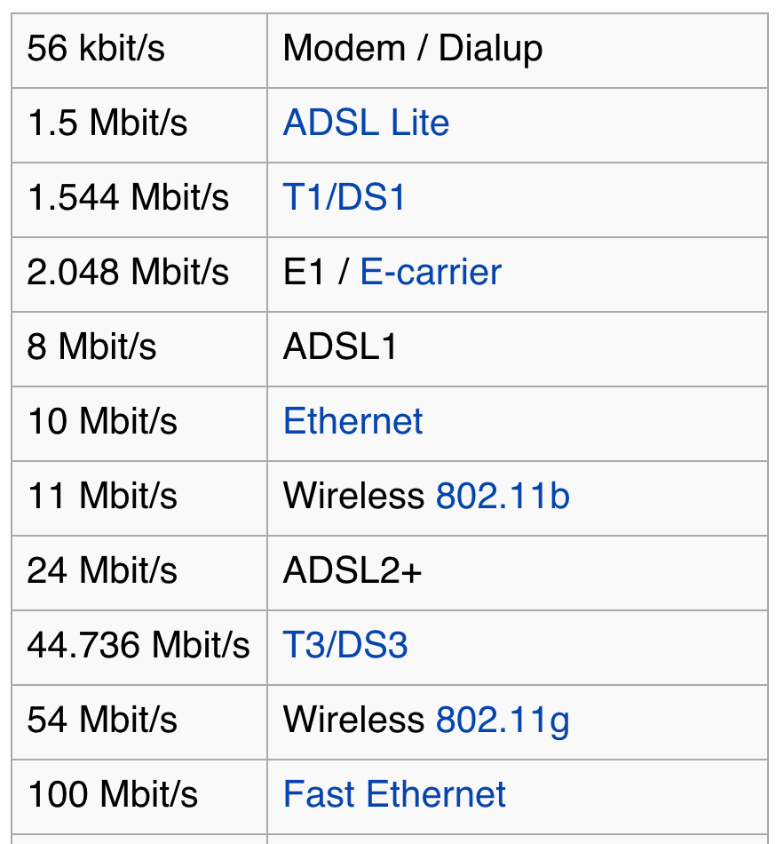
Bandwidth and Latency
en.wikipedia.org/wiki/Network_performance#Bandwidth
The size and speed of systems affect their use.
E.g., Netflix on dialup? Nope.
Bandwidth
a measure of bit rate—the amount of data (measured in bits b) that can be sent in a fixed time. Usually b/s
Latency
the time elapsed between the transmission and the receipt of a request. Usually ms.
Bit Rates. Wikipedia

Slide 20
Clicker Question
What has the highest bandwidth?
Wireless networks
Wired networks
Your hard drive and your computer
Your CPU and its scratch space
A truck of MicroSD cards going next door
Notes:
Data and information is hard to define. There are philosophical and meta-physical issues. So let’s all watch the Matrix…

Slide 21
(Cal) Clicker Question
what-if.xkcd.com/31
What has the highest bandwidth?
Wireless networks
802.11ac = 1.3 Gbps
Wired networks
10 GigE = 10 Gbps
Your hard drive and your computer
Thunderbolt 2 = 20 Gbps
Your CPU and its scratch space
At 4 GHz, 4 bytes / .25 ns = 16 GBps = 128 Gbps
A truck of MicroSD cards going next door
xkcd’s author calculates it to be 177 petabytes/s = 177,000,000 Gbps
Notes:
Data and information is hard to define. There are philosophical and meta-physical issues. So let’s all watch the Matrix…

Slide 22
Internet Cyber security

Slide 23

Cyber Security
en.wikipedia.org/wiki/Computer_security
en.wikipedia.org/wiki/Web_of_trust
DNS was not designed to be completely secure
Implementing cybersecurity has software, hardware, and human components
Phishing, viruses, and other attacks have human and software components
Cyber warfare and cyber crime have widespread and potentially devastating effects
Distributed denial-of-service attacks (DDoS) compromise a target by flooding it with requests from multiple systems
Antivirus software and firewalls can help prevent unauthorized access to private data
Edward Snowden. Wikipedia (Hic et nunc)

Slide 24
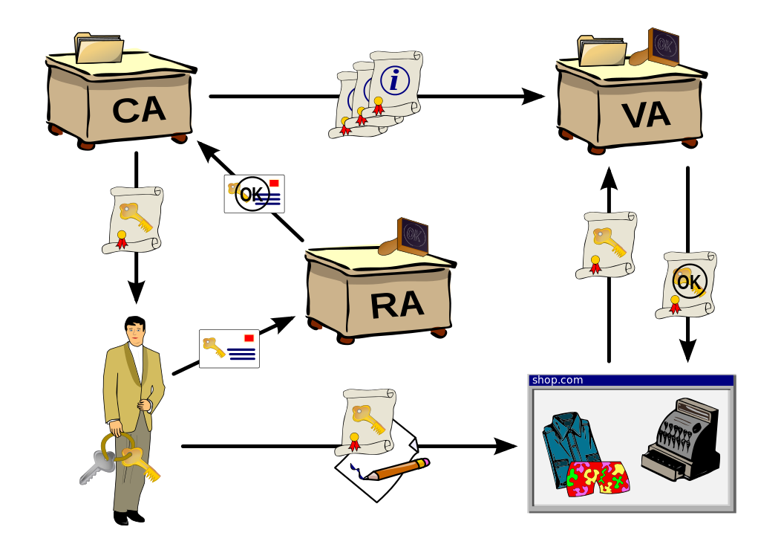
Cryptography
en.wikipedia.org/wiki/Public_key_infrastructure
Cryptography is
essential to many models of cybersecurity
has a mathematical foundation
Open standards help ensure cryptography is secure
Symmetric encryption is a method of encryption involving one key for encryption and decryption
Public key encryption (not symmetric) is an encryption method that is widely used because of the functionality it provides
Certificate authorities (CAs) issue digital certificates that validate the ownership of encrypted keys used in secured communications and are based on a trust model
The trust model of the Internet involves trade-offs.
Public Key Infrastructure. Wikipedia (Chrkl)
“As time goes on, you will accumulate keys from other people that you may want to designate as trusted introducers. Everyone else will each choose their own trusted introducers. And everyone will gradually accumulate and distribute with their key a collection of certifying signatures from other people, with the expectation that anyone receiving it will trust at least one or two of the signatures. This will cause the emergence of a decentralized fault-tolerant web of confidence for all public keys.” – Phil Zimmerman, PGP author
Notes:
Principle of a public key infrastructure. Rough outline: A user applies for a certificate with his public key at a registration authority (RA). The latter confirms the user's identity to the certification authority (CA) which in turn issues the certificate. The user can then digitally sign a contract using his new certificate. His identity is then checked by the contracting party with a validation authority (VA) which again receives information about issued certificates by the certification authority.

Slide 25

Public Key Encryption
www.youtube.com/watch?v=3QnD2c4Xovk

